Slide 1

Empowering Global Financial Services with CryptoMe, Inc.

Slide 2

Content
1. Unveiling the Vision
2. Revolutionizing Cryptocurrency Transactions
3. Market Opportunity and Growth
4. The Future of CryptoMe

Slide 3

Unveiling the Vision
Section 1

Slide 4



Mission and Vision
Democratizing Financial Services
Providing accessible, fast, and secure cryptocurrency transactions for the unbanked and bank-averse.
Leading the Way
Revolutionizing global financial services through a secure, user-centric cryptocurrency platform.
01
02

Slide 5


Addressing Challenges
Lack of Access to Traditional Banking
Millions worldwide face barriers to traditional banking.
Issues with Existing Cryptocurrency Platforms
Slow, expensive transactions and lack of user control over funds.

Slide 6

Revolutionizing Cryptocurrency Transactions
Section 2

Slide 7
The CryptoMe Solution
Cross-Platform App
Simplifying cryptocurrency transactions, offering rapid transfers using XRP.
Empowering Users
Full control over funds through decentralized wallets and access to secret keys.
01
02

Slide 8


Partnership with Changelly
Efficient Currency Conversions
Easy and efficient currency conversions through a revenue-sharing model.
Enhanced Service Offering
Addressing the need for seamless currency conversions and user empowerment.

Slide 9
Market Opportunity and Growth
Section 3

Slide 10


Untapped Market
Global Cryptocurrency Market
The global cryptocurrency market, projected to grow from $51.5 billion in 2024 to $71.7 billion by 2028, is driven by increasing adoption across various sectors and regions, with significant growth led by the Asia Pacific and North America
Targeting the Unbanked
Providing secure, fast, and accessible financial transactions for the unbanked and bank-averse.

Slide 11
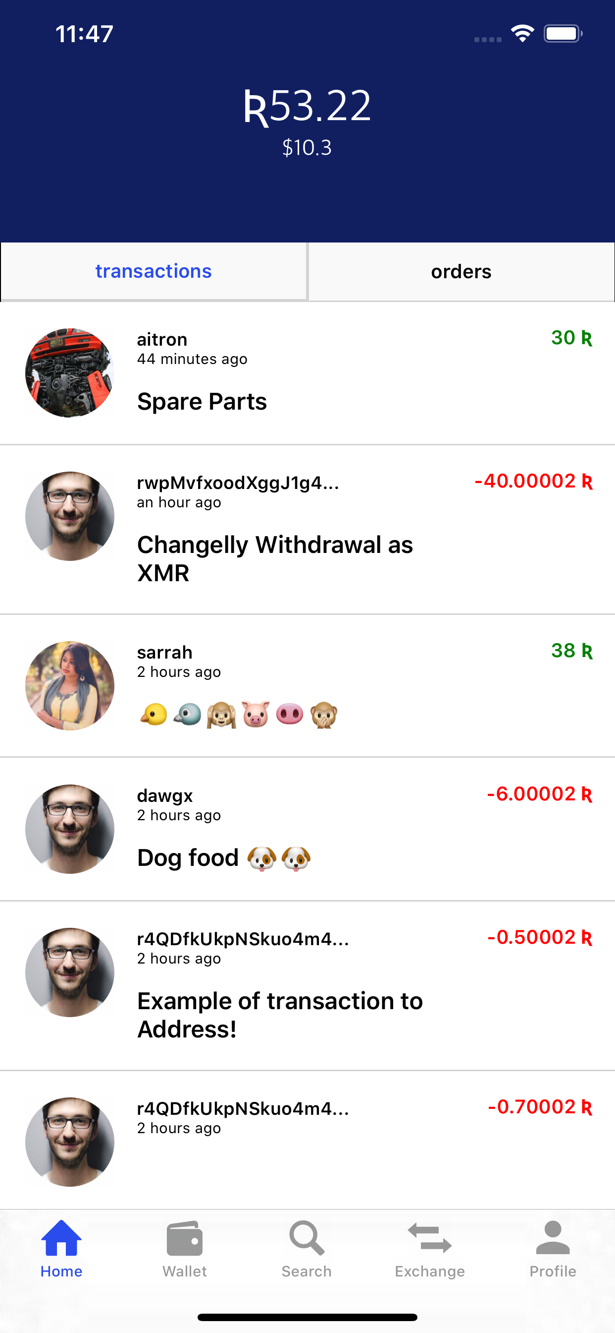
Product Overview
Walkthrough of CryptoMe App
CryptoMe guides users from a simple sign-up or login process, through adding funds to their wallet, executing instant transactions or exchanges with minimal fees using XRP or other supported cryptocurrencies, to finally withdrawing funds or managing their account settings, all within a secure and user-friendly interface.
Upcoming Features
Support for additional cryptocurrencies and B2B payment solutions.

Slide 12
The Future of CryptoMe
Section 4

Slide 13


Technology & Security
Responsive Technology Stack
DynamoDB, Express.js, Node.js, and React Native for a cross-platform experience.
Unparalleled Security Measures
AES encryption and sharded keys strategy for protecting users' funds.

Slide 14

Business Model & Competitive Analysis
Revenue Streams
Transaction fees, revenue share from Changelly, and competitive fee structures.
Key Differentiators
User control over funds, security measures, and focus on banking the unbanked.

Slide 15
Team & Financial Projections
Founding Team and Partnerships
Highlighting expertise in technology, finance, and blockchain.
Financial Projections
Projected revenue growth and milestones for success.
01
02

Slide 16
Call to Action
Join the Revolution
Invitation for investors to be part of revolutionizing cryptocurrency transactions.
Contact Information
devanshpatel22@gmail.com
4237675038
01
02

Slide 17

Thank You
Contact: devanshpatel22@gmail.com

